Slide 1
INTERN Performance Intelligence System

Slide 2
Problem Statement
In real organizations, intern evaluation is:
Subjective
Based on limited metrics
Not standardized
Problems:
Hard to identify true performers
Biased decisions
No structured system

Slide 3
Solution Overview
👉 Built a Data-Driven Evaluation System
✔ Multi-parameter evaluation ✔ KPI-based ranking ✔ Interactive dashboard ✔ Business insights generation

Slide 4
Project Flow (Simple View)
DATA
CLEANING
ANALYSIS
KPI MODEL
DASHBOARD
INSIGHTS

Slide 5
TECH STACK
Python → Core development
Pandas → Data processing
NumPy → Data generation
Matplotlib → Analysis visualization
Plotly → Interactive charts
Streamlit → Dashboard UI
Excel/CSV → Data storage

Slide 6
Sprint 1 (Data Preparation)
WHAT
WHY
Raw data:
Is inconsistent
Cannot be directly analyzed
👉 Preprocessing ensures:
Accuracy
Consistency
HOW
Removed invalid values
Ensured logical constraints
Created new features
Generated dataset (300 interns)
Added performance parameters
Cleaned and validated data

Slide 7
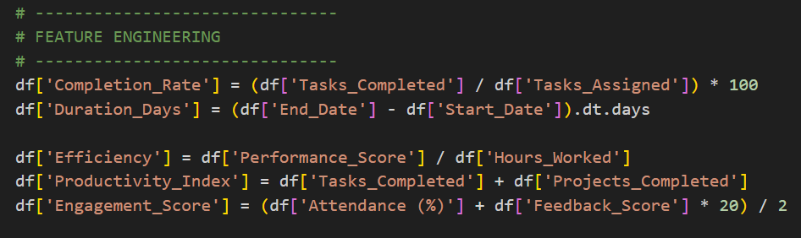
Sprint 1 (Feature Engineering)
WHAT ADDED
Completion Rate
Duration Days
WHY ADDED
Basic data cannot measure:
Efficiency
Productivity
These features make data analysis-ready

Slide 8
Sprint 2 (EDA)
WHAT
Statistical analysis
Correlation study
Department analysis
Mentor analysis
Visualizations
WHY
EDA helps:
Understand patterns
Identify key drivers

Slide 9
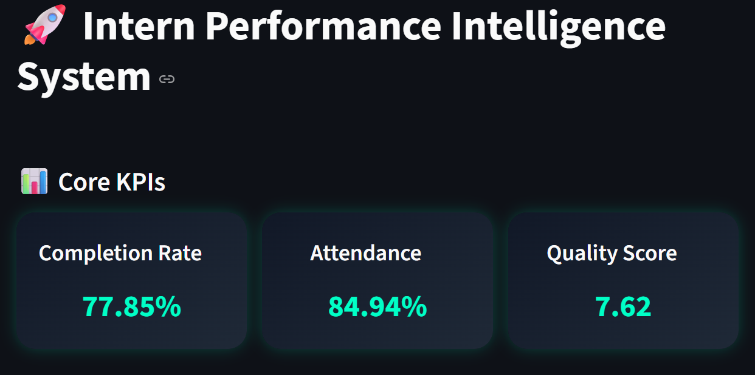
Key Insights (EDA)
Completion rate → strong impact
Quality → differentiates performers
Attendance → ensures consistency
Mentors → influence outcomes

Slide 10
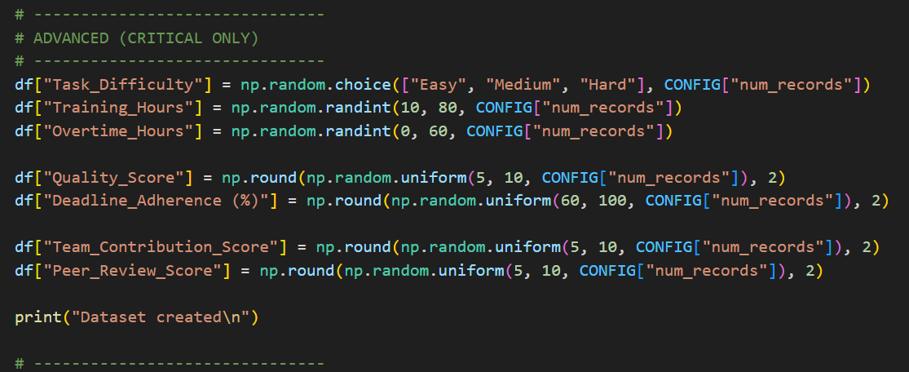
Why New Parameters?
❌ Basic metrics are insufficient
👉 Added:
Time efficiency
Deadline adherence
Behavioral metrics
Contribution metrics
✔ Makes system real-world applicable

Slide 11
Sprint 3 (KPI Design)
CORE IDEA
👉 Evaluate interns using multiple dimensions
Dimension | Parameter
Productivity | Completion Rate
Consistency | Attendance
Quality | Quality Score
Time | Deadline Completion
Efficiency | Duration
Contribution | Projects
Behavior | Obedience

Slide 12
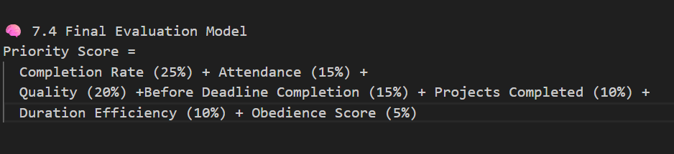
KPI Model (PS INDEX)
Priority Score:
Completion Rate (25%)
Attendance (15%)
Quality (20%)
Deadline Completion (15%)
Projects (10%)
Duration (10%)
Behavior (5%) = priority score
WHY KPI?
✔ Balanced evaluation ✔ Avoids bias ✔ Reflects real company logic

Slide 13
Top Performers(Ultimate insight)
WHAT :
WHY :
HOW :
RANKS FOR TOP STUDENTS IN
THEIR RESPECTIVE DEPT
Top 3 interns per department
Enables comparison
Encourages competition
Identifies consistency
👉 Ranked using
Priority Score

Slide 14
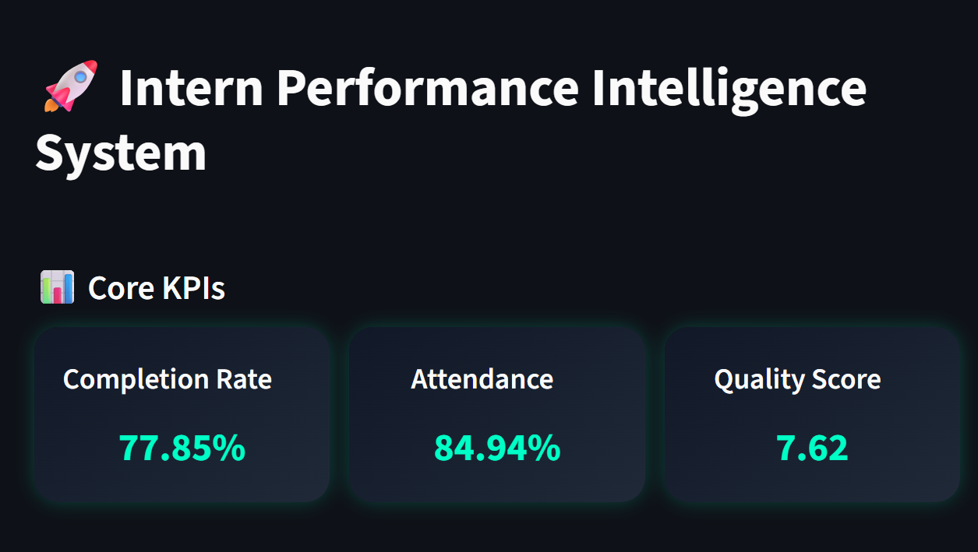
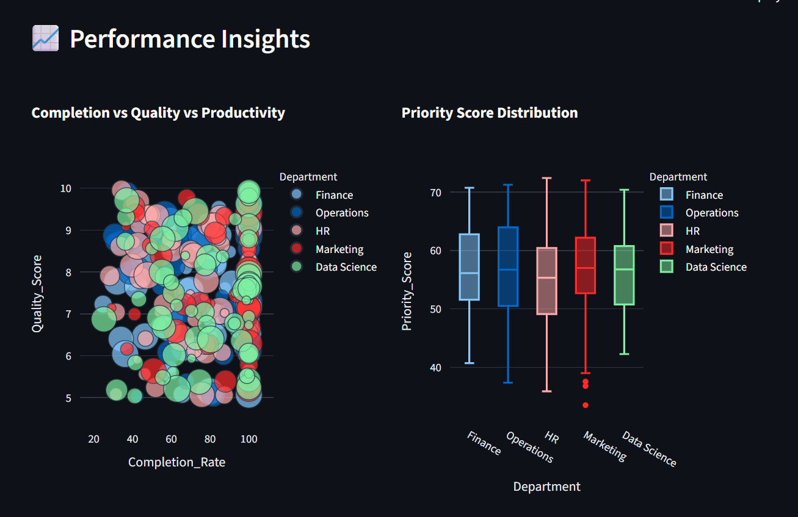

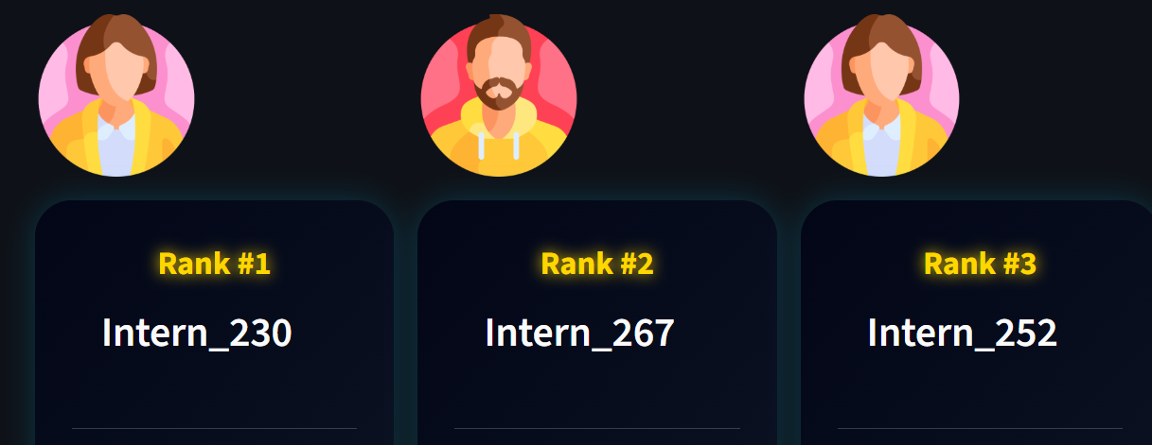
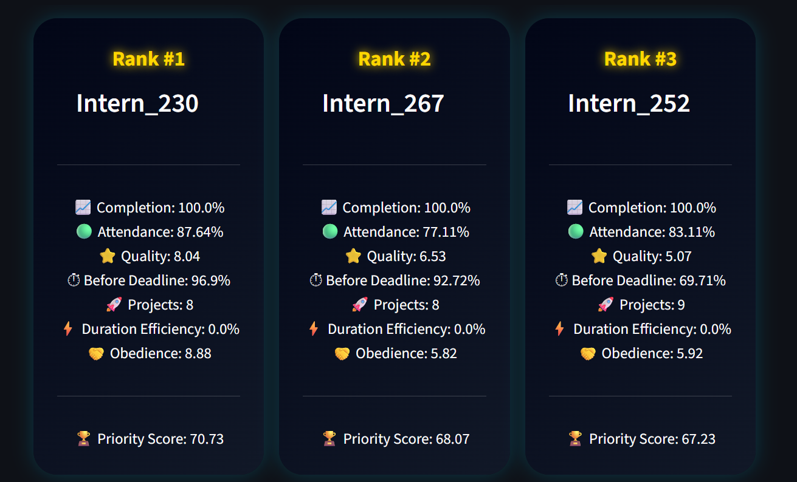
Dashboard (Sprint 3)
USING ( STREAMLIT )
FASTER, SIMPLE AND
EFFECTIVE ORGANISATION
✔ Interactive charts ✔ KPI-based ranking ✔ Top performer profiles ✔ Filters

Slide 15
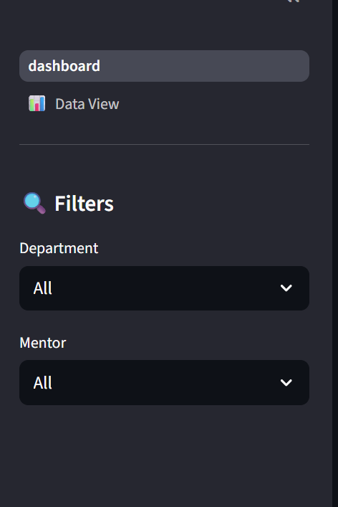
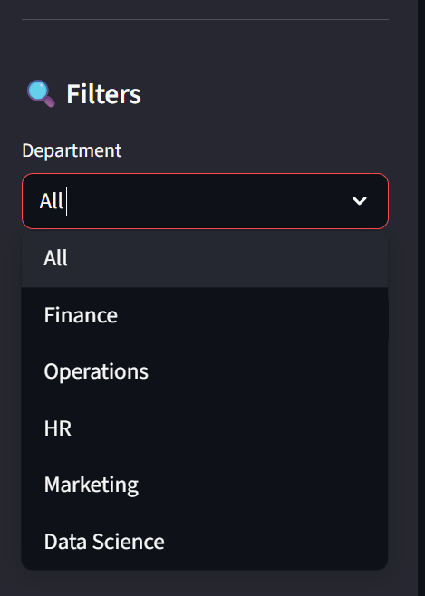
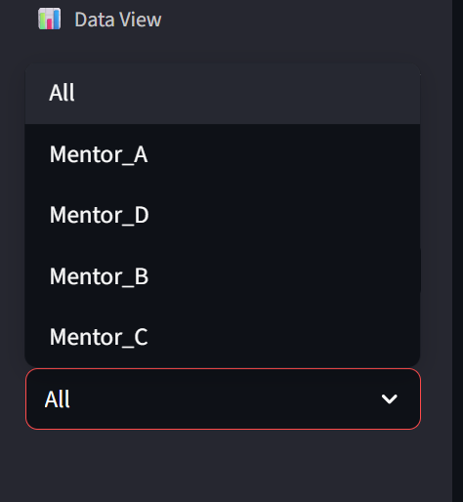
Why Filters ?
Department → Compare domains
Mentor → Evaluate training
👉 Enables:
Drill-down analysis
Better decisions

Slide 16
INSIGHTS
High completion → high performance
Faster work → better ranking
Quality separates top performers
Behavior impacts evaluation

Slide 17
Sprint 4 (Final Delivery)
✔ Dashboard completed ✔ Insights generated ✔ Documentation prepared

Slide 18
Business Value
Objective evaluation system
Identifies top talent
Improves training
Supports hiring decisions

Slide 19
Conclusion AND Final Statement
THIS SYSTEM EVALUATION
❌ Traditional → Subjective
✅ This system → Data-driven
This project transforms :
HIRES EMPLOYTESS FROM INTERNS BASED ON
❌ Raw intern data ✅ DATA–DRIVEN Structured performance intelligence
FINAL STATEMENT
👉 A ORGANIZATION can use this system to hire full-time employees from interns based on data-driven
performance evaluation.

